Slide 1


SBAB
To do: A recording of our focus…
Governance, Risk and Compliance
Focus on AI Act and GDPR

Slide 2
Our System views
To do: A recording presenting our approach…
Monitor AI
Risk and Compliance
Enforce Gard Rails
Track performance
Generate Reports
Optimise Cost

Slide 3
Demo
To do: A recording of our demo hack…

Slide 4
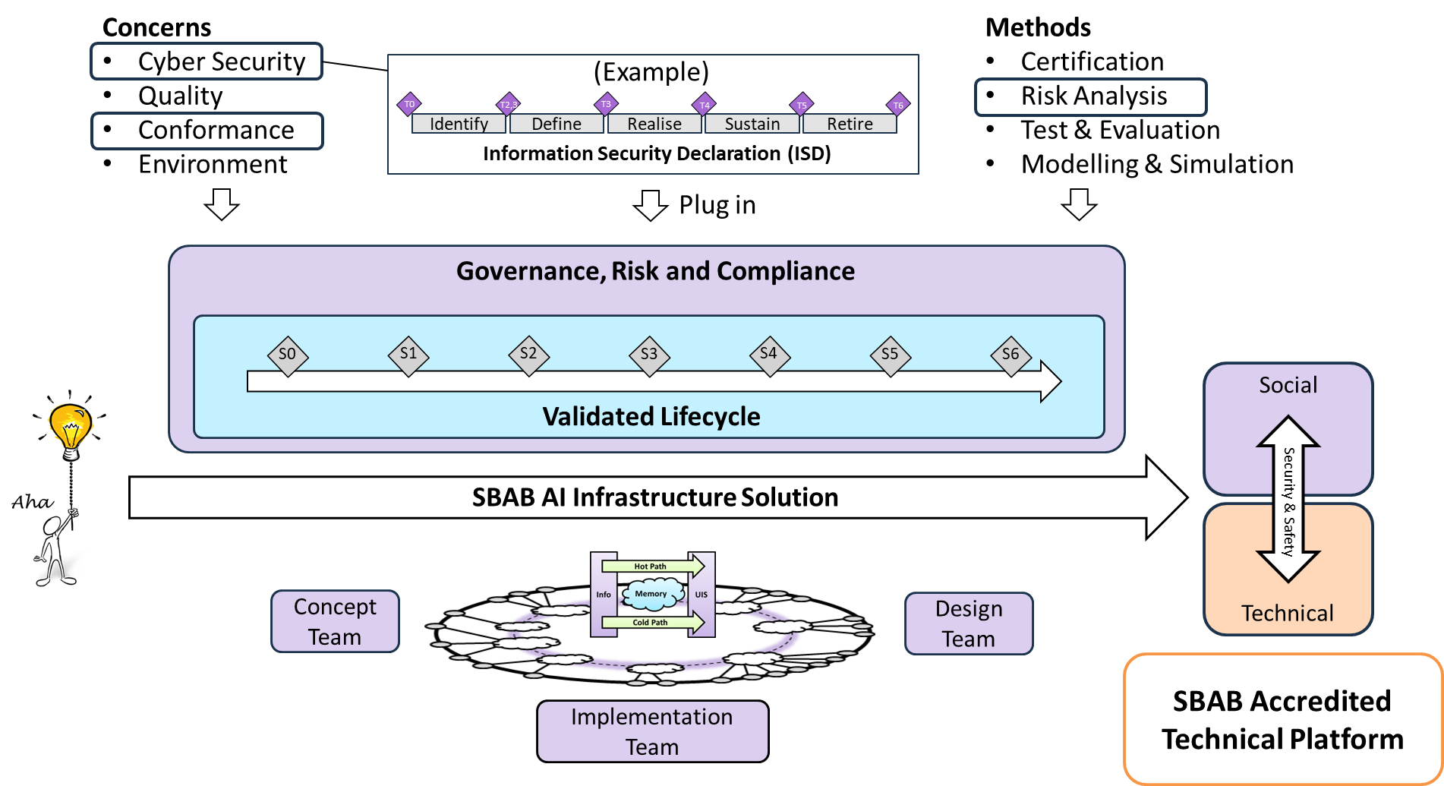
What’s next Governance, Risk and Compliance
To do: A recording of our proposed next step…
The picture shows how a custom defined cyber security process (fmv.se) integrates into a production workflow.
Build an automated compliance and governance infrastructure that monitors all AI traffic

